Slide 1
Predicting Household Income vs Expenditures Week 2
Github Repo: Household Income
ReadME: Household Income and Expenditures
-------------------------------------------------------
A Brief Explanation on the ML Model:
70/30 split
Reshape to fit LSTM model
It’s a 3 dimension model using (x, y, X)
Compile
Train
Predicted outcome with 100 epochs using Sklearn
Database Description: Cleaning database to create a income and expenditure table with Python then merged the tables in SQL , then created files for years 2019- 2022 to predict 2023.
-------------------------------------------------------------------------------------
Storyboard:
Week 1
Importing csv and cleaning data
Pandas writing basic structure
SQL creating initial tables
Week 2
Pandas/Python for cleaning and ML model
Refining SQL tables
Tableau for graphs

Slide 2
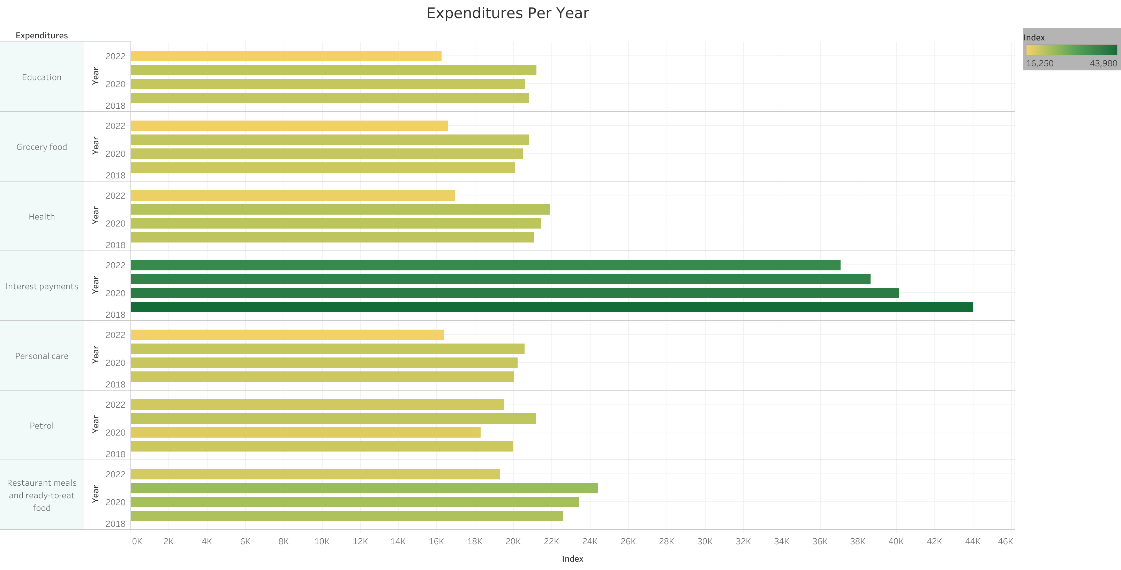

Slide 3
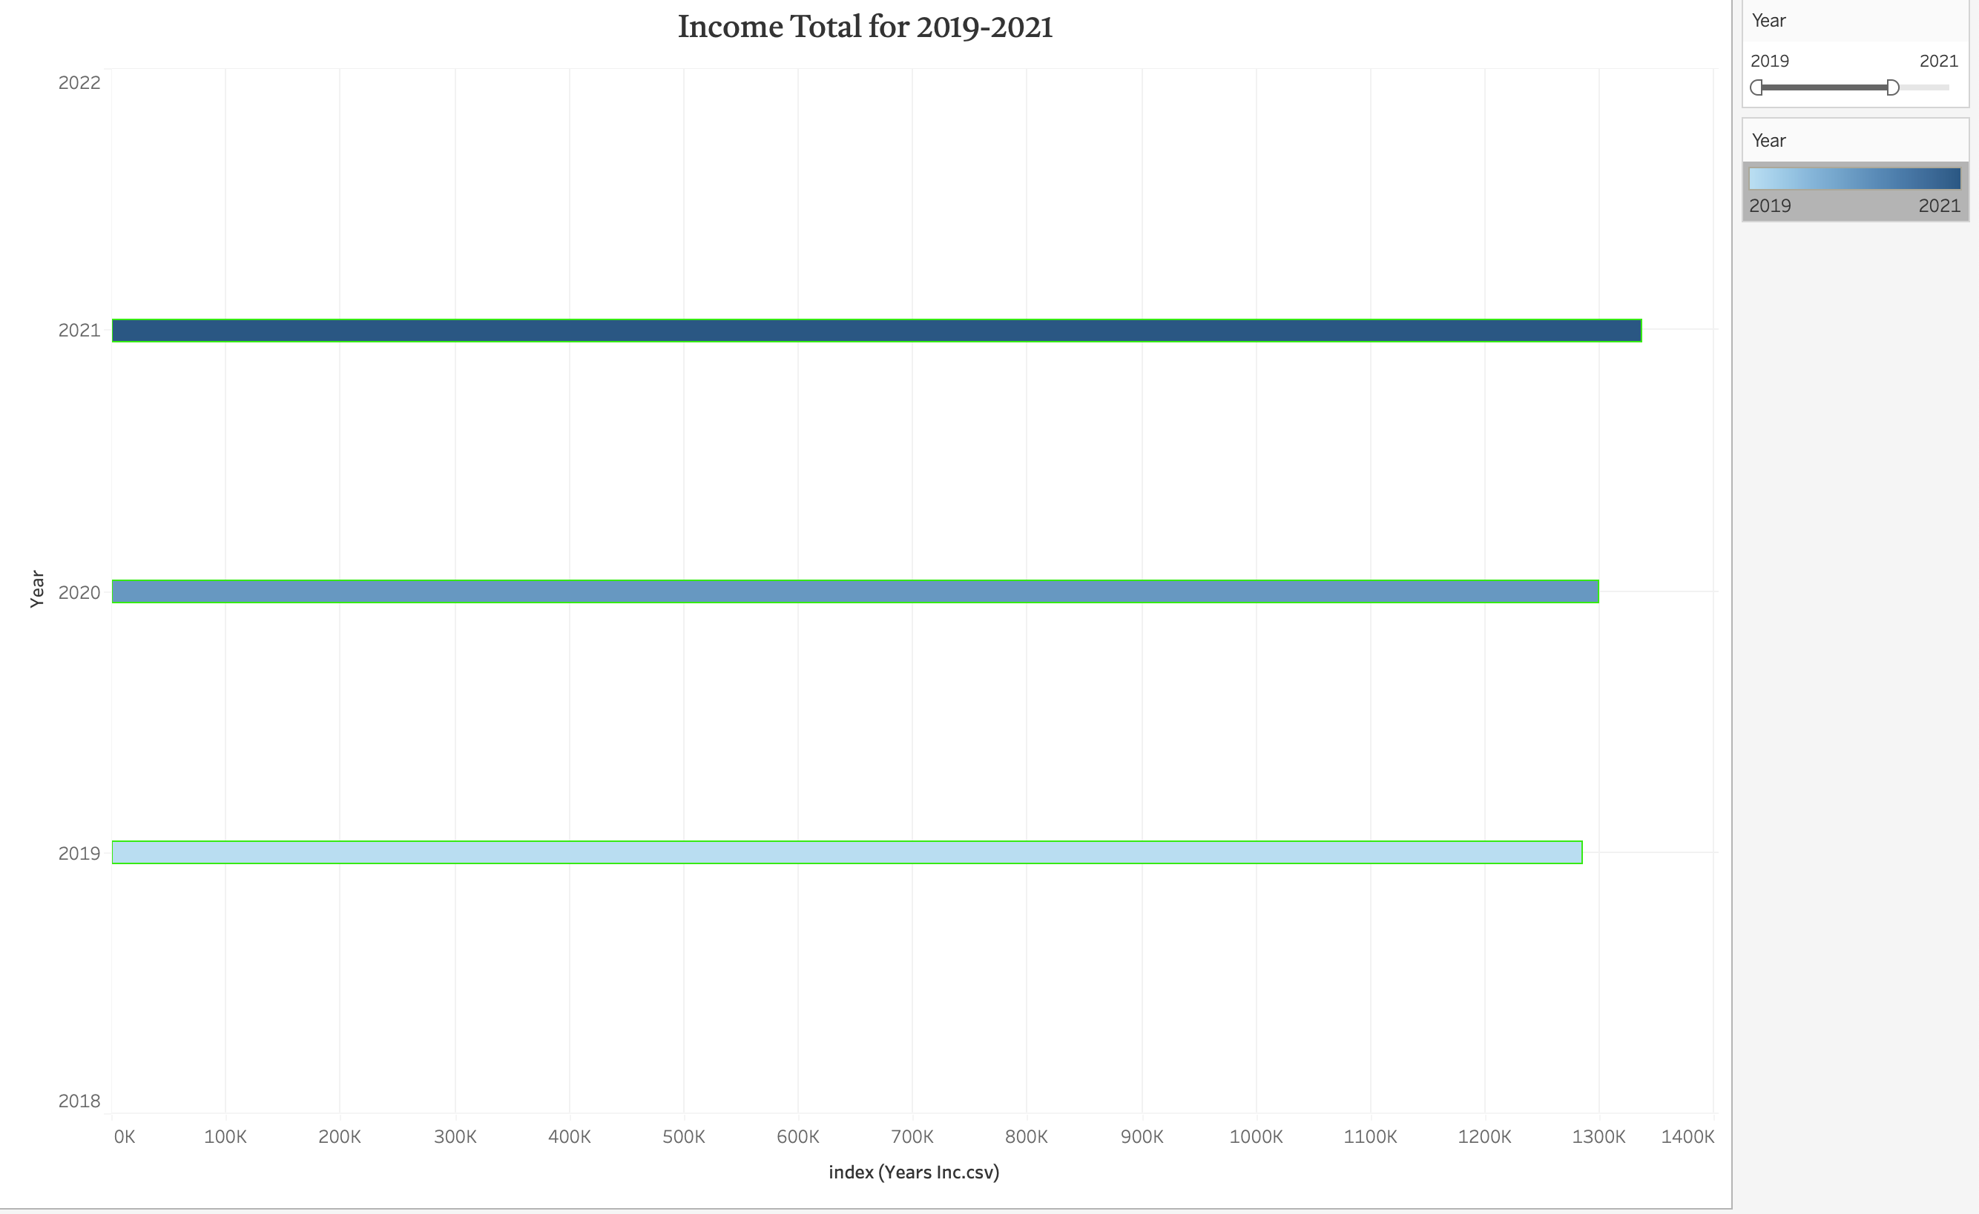

Slide 4
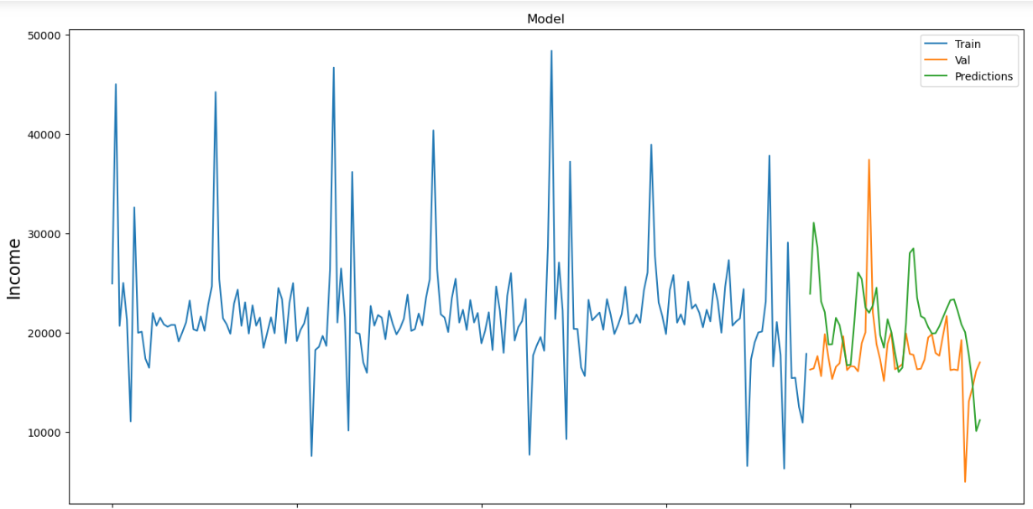

Slide 5
